Slide 1
ISOMETRIC VIEWS (Practice Problems)
Rahul Sharma

Slide 2
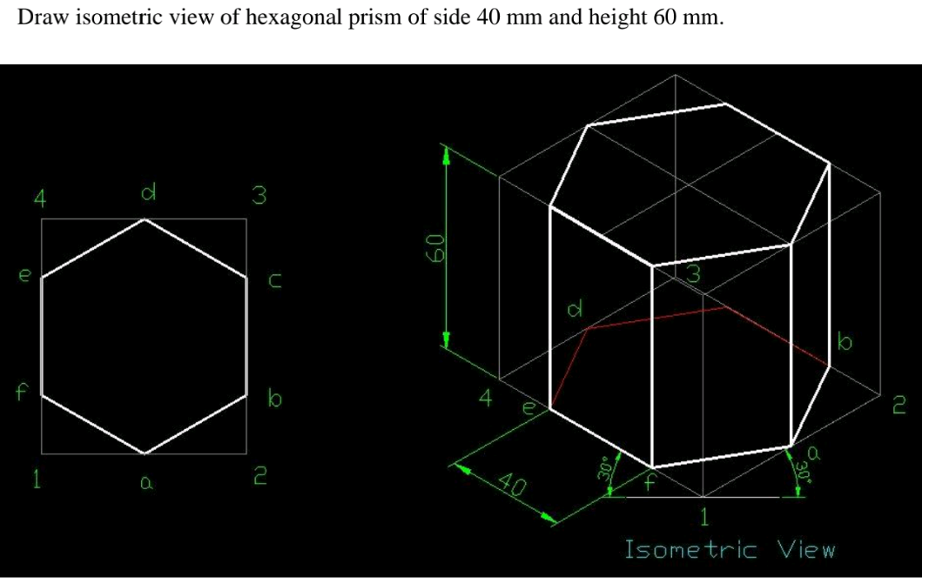
Hexagonal Prism

Slide 3
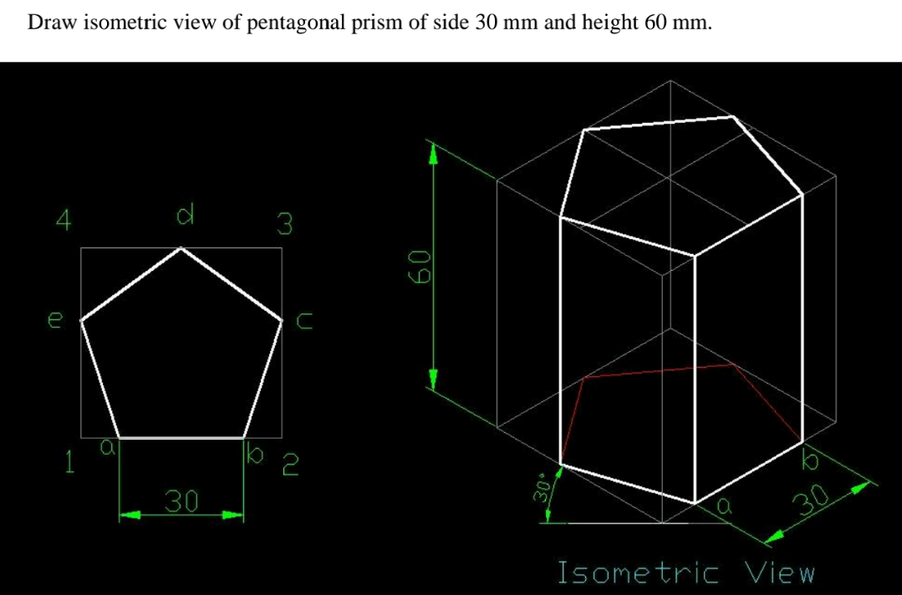
Pentagonal Prism

Slide 4
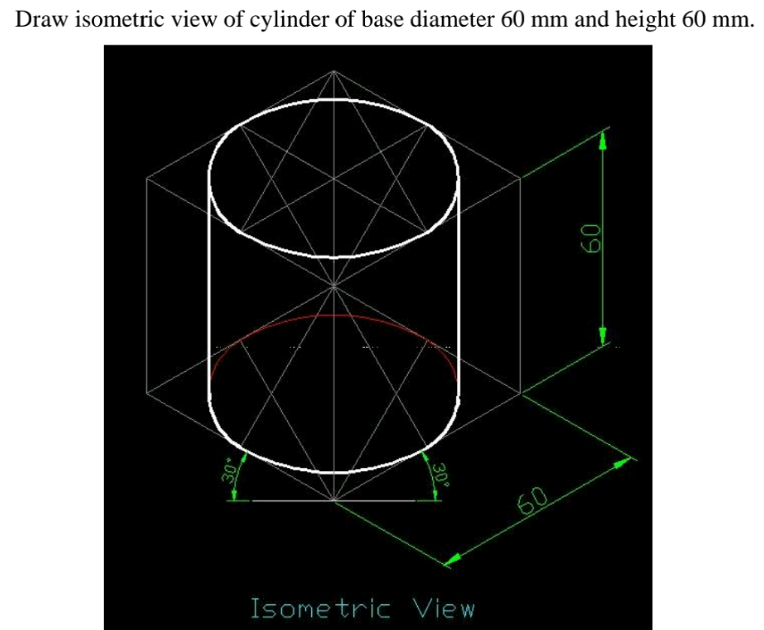
Cylinder

Slide 5
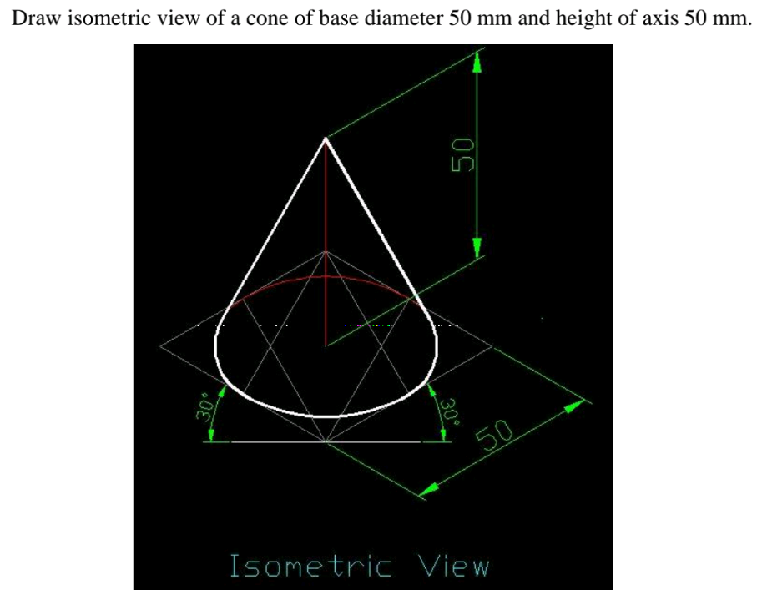
Cone

Slide 6
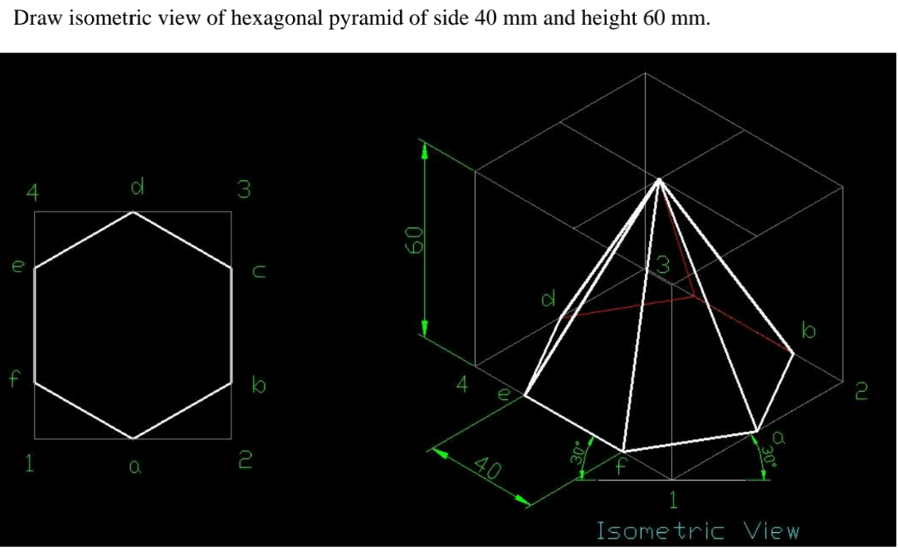
Hexagonal Pyramid

Slide 7
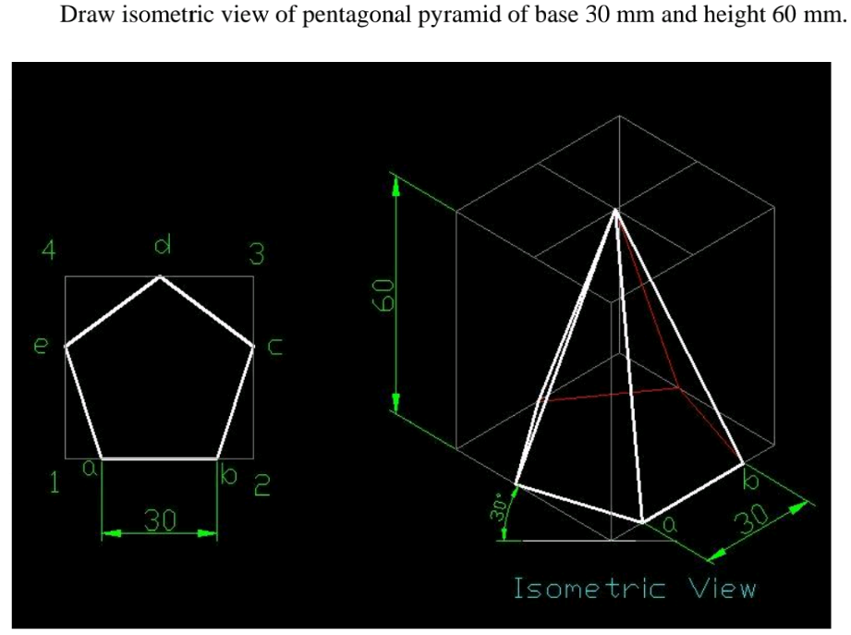
Pentagonal Pyramid

Slide 8
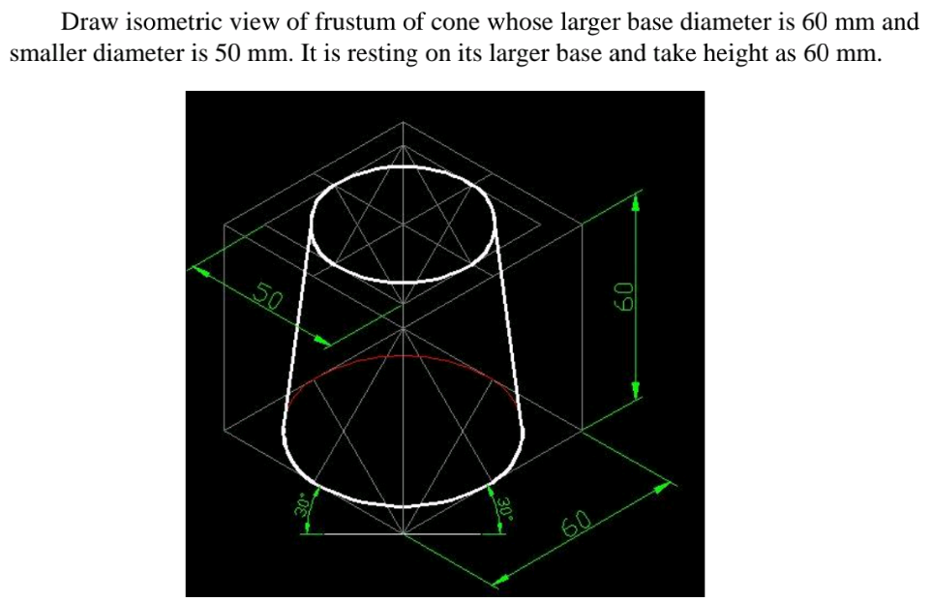
Frustrum of Cone

Slide 9
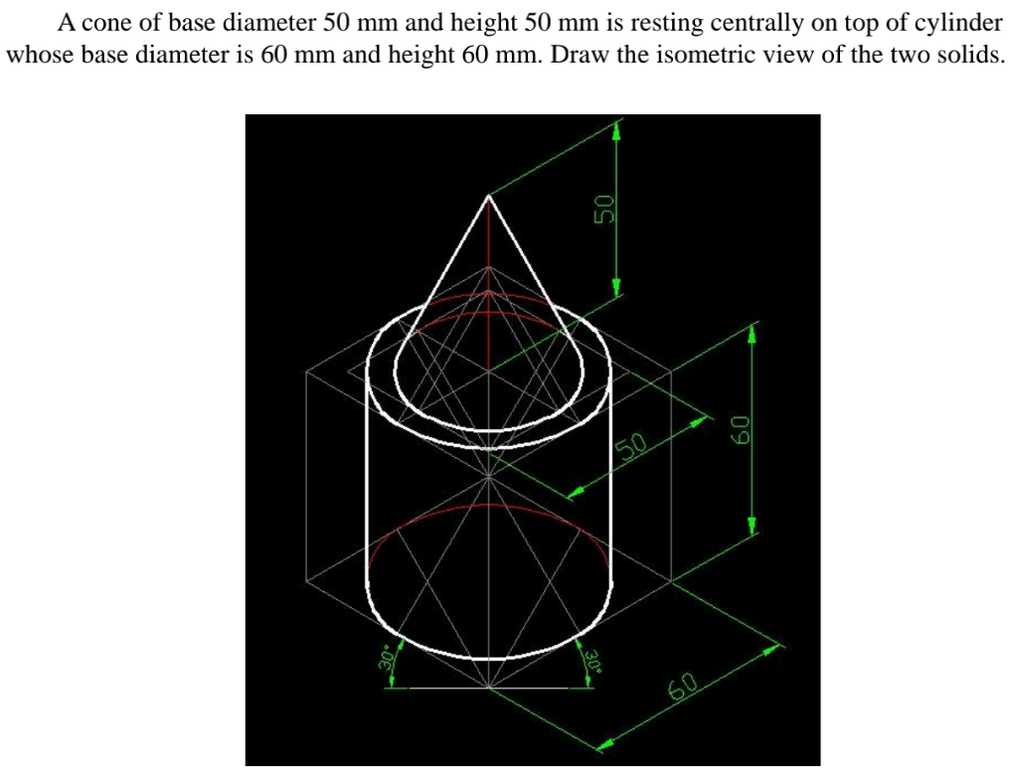
Cone Resting on Cylinder

Slide 10
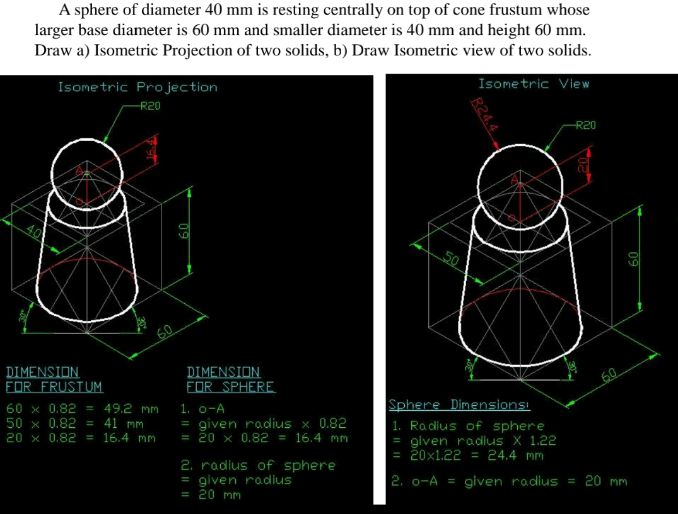
Sphere Resting on Top of Frustrum of Cone

Slide 11
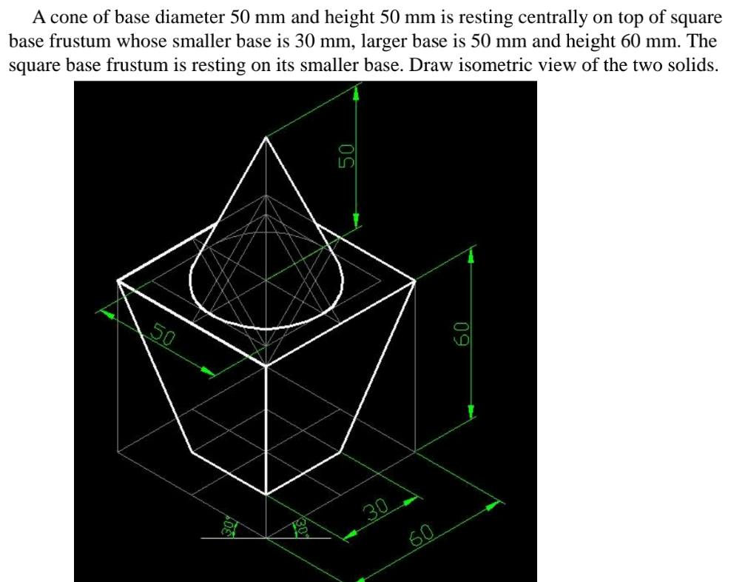
Cone Resting on Square Base Frustrum

Slide 12
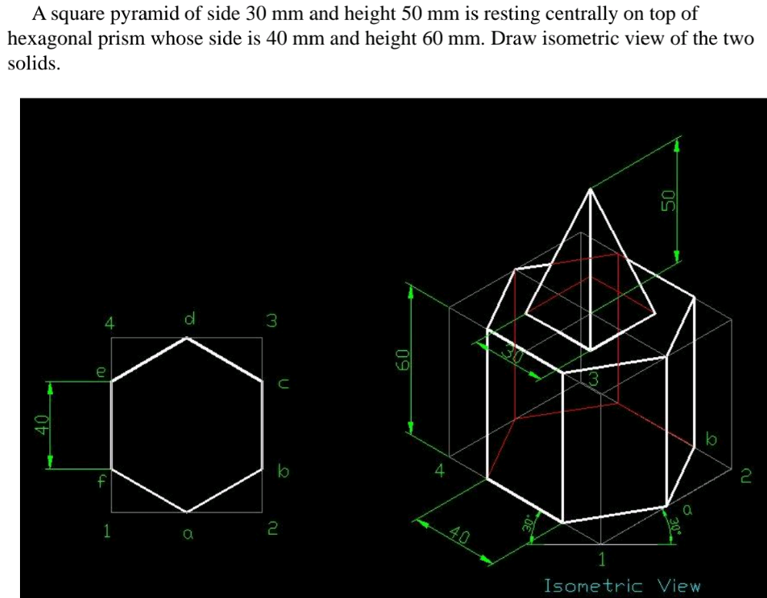
Square Pyramid Resting on Hexagonal Prism

Slide 13
Thank You

